Slide 1
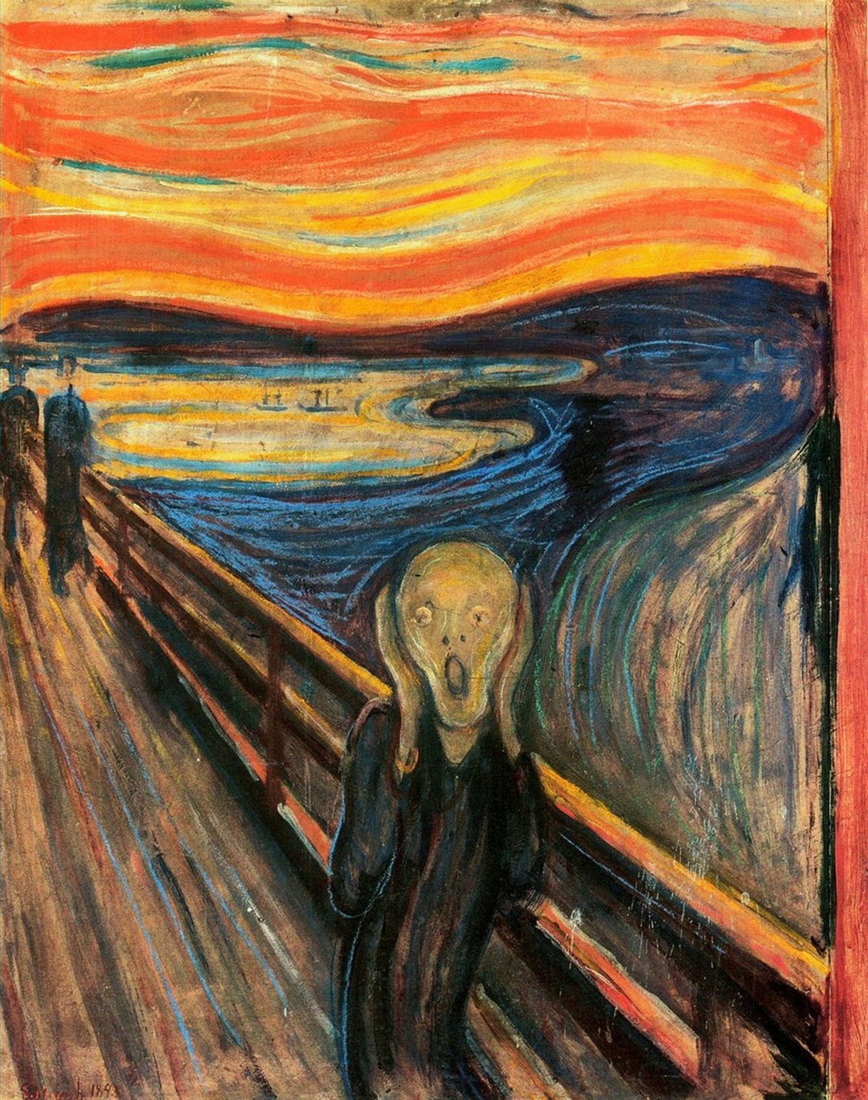
Physics in Crisis

Slide 2
Kuhn thus far…
Fact
Theory
Discovery
Invention

Slide 3
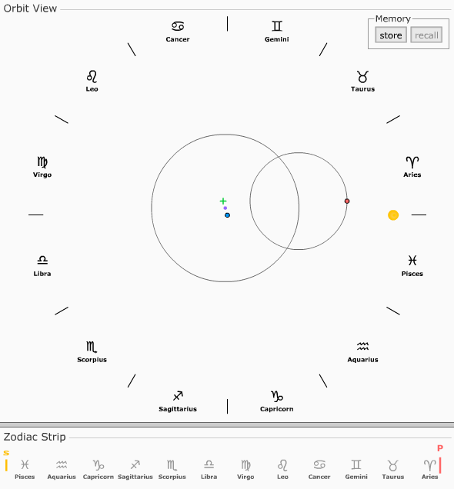
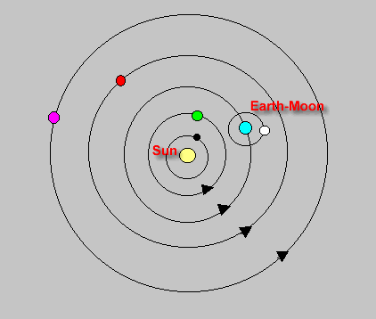
Kuhn Chapter 6…
The Copernican Revolution

Slide 4
Revolutions and Paradigm “Shift”
You are never without a paradigm if you operate within a scientific tradition (SSR, pg 79)
Revolution is a rapid and incommensurable replacement of one paradigm by another
Paradigm shift entails a “gestalt” change, adoption of a new worldview
Medieval World (Aristotle)
Classical World (Newton)
Quantum World (Planck)
1685
1900

Slide 5
Problem of Realism
Do scientific theories “mirror” the world? – Do atoms exist or are they theoretic constructs?
How do minds influence theories which in turn influence observation which in turn…
Is the world “real” and knowable – Is our knowledge gained through scientific observation accurately describing an underlying reality?
Naïve realism – scientific theories and their constructs “map” directly to an independently existing world
Scientific realism - the view that the world described by science is the real world
Critical realism – the real world exists independent of us but can only be known through “myths, models and metaphors”

Slide 6
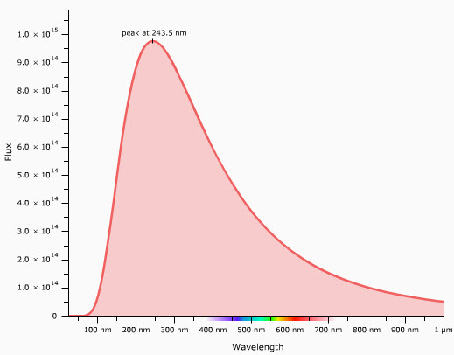
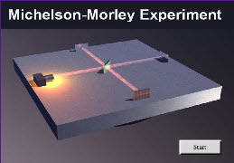
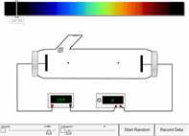
Cracks in the Foundation!
The persistent (and annoying!) problem of blackbody spectra
Failure of the Michelson-Morley Experiment
The photoelectric effect – light is a “particle”

Slide 7
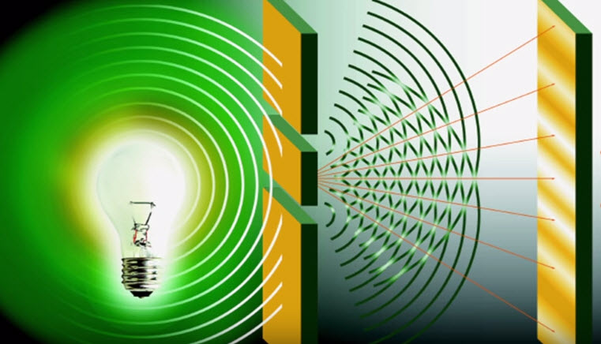
Discovery of the Quantum
The universe is quantized
Light is both a particle and a wave!
A first glimpse at Quantum Weirdness!

Slide 8
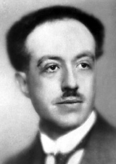
“Particles are Waves”!
Louis de Broglie (1924)
via Einstein’s mass-energy equivalence suggests “particles are waves”
Wave-nature of electron experimentally verified by Davissson and Germer in 1927

Slide 9
The Wave-Particle Duality
At its core quantum physics exposes a deep puzzle - the “basic stuff” of the universe is, in a profoundly disturbing way, beyond our ability to capture or “enframe” in language.
An electron, for example, can exhibit both “wave” or “particle” behaviour depending on how we interact with it.

Slide 10
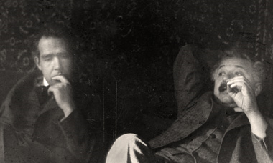
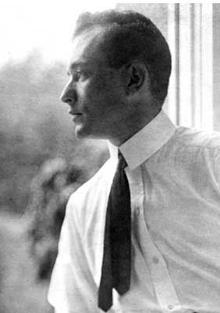
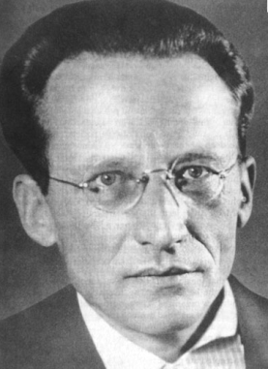
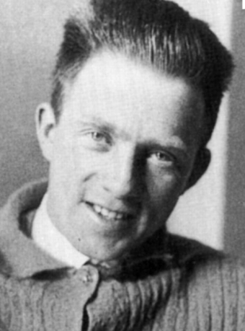
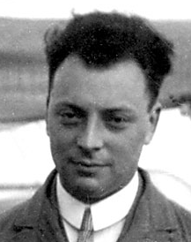
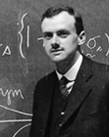
The Birth of Quantum Theory…
From 1925 – 1930 a radically new way to look at the physical world was developed
Quantum Theory is one of the most successful theories ever devised
It has yet to “fail” a test given it
… but

Slide 11
Copenhagen Interpretation
There is no underlying physical reality
We create reality through our interaction with the world
Physics cannot tell us what the world is “really made of” – Bohr would argue that this question ultimately has no meaning.
Quantum theory deals with possibilities and probabilities – the world takes on an indeterminacy
Despite this QT still is a mathematically precise (and in a new sense) can still be a deterministic theory

Slide 12
Some Highlights…
Heisenberg Uncertainty Principle
Wave-particle
duality
Compton
scattering
Particle in a box
?
Quantum Weirdness and
Non-locality
Electron
diffraction
Schroedinger’s Cat

Slide 13
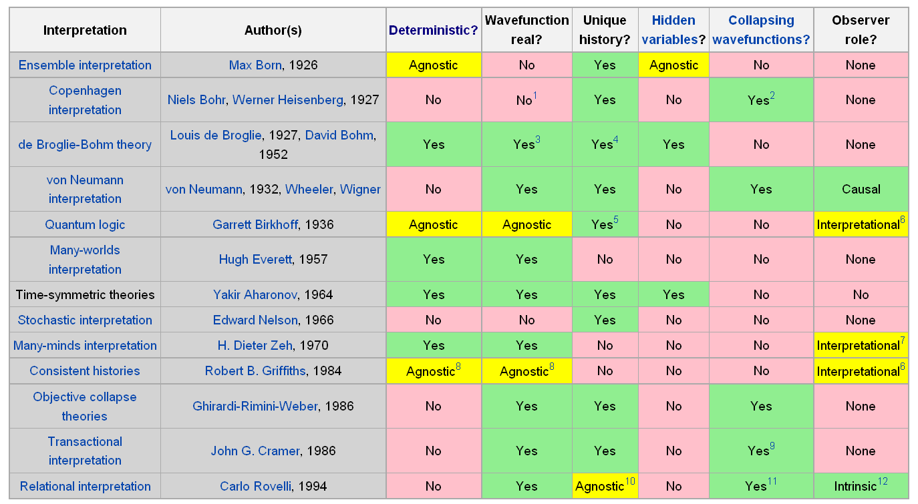
QT comes in Many Flavours!

Slide 14
Many-Worlds and the Cat!

Slide 15
What do we “make of this”?
QT is the “best” physical theory we have ever devised! It forms the bed-rock on which modern physics, chemistry and biochemistry is built.
QT cannot provide us with a picture of the quantum world that we can fully comprehend at a conceptual level – the “quantum world” is quite unlike the macroscopic world that we live in
Is the material world fully comprehensible?
Is Hawking’s goal “However, if we do discover a complete theory it should, in time be understandable in broad principle by everyone, not just a few scientists.’’ attainable?

